Slide 1
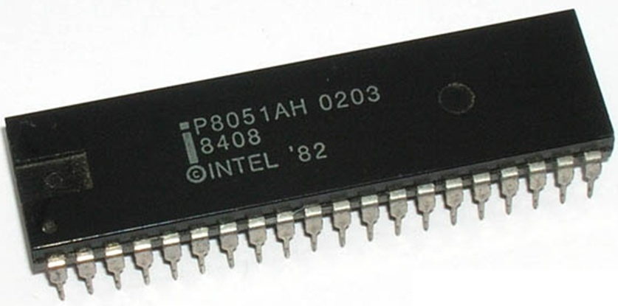
8051
Microcontroller

Slide 2
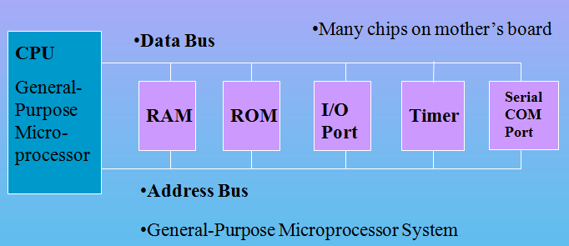
Microprocessor Based System
CPU
External RAM, ROM, I/O
(No internal RAM, ROM, I/O ports in the CPU)

Slide 3
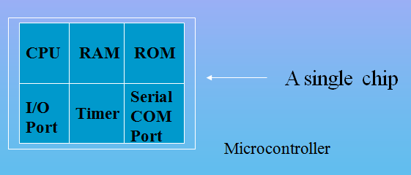
Microcontroller
A smaller computer on a CHIP
On-chip RAM, ROM, I/O Ports, Timer, Serial Controller…
Example: Motorola’s 6811, Intel’s 8051, Atmel 32

Slide 4
Microprocessor vs. Microcontroller
Microprocessor
CPU is stand-alone, RAM, ROM, I/O, timer are separate.
Designer can decide on the amount of ROM, RAM and I/O ports.
Expansive
Versatility
General-purpose
Microcontroller
CPU, RAM, ROM, I/O and timer are all on a single chip
Fixed amount of on-chip ROM, RAM, I/O ports df dfdfdfdfdfdfdf
Not Expansive
Single-purpose
Special Purpose.

Slide 5
μC based Embedded Systems
Special purpose computer system usually completely inside the device it controls
Has specific requirements and performs pre-defined tasks
Cost reduction compared to general purpose processor
Different design criteria
Performance
Reliability
Availability
Safety

Slide 6

Embedded Systems Examples

Slide 7

Examples

Slide 8
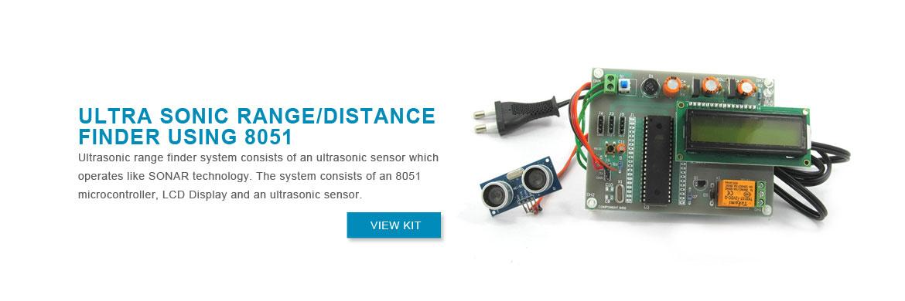

Slide 9
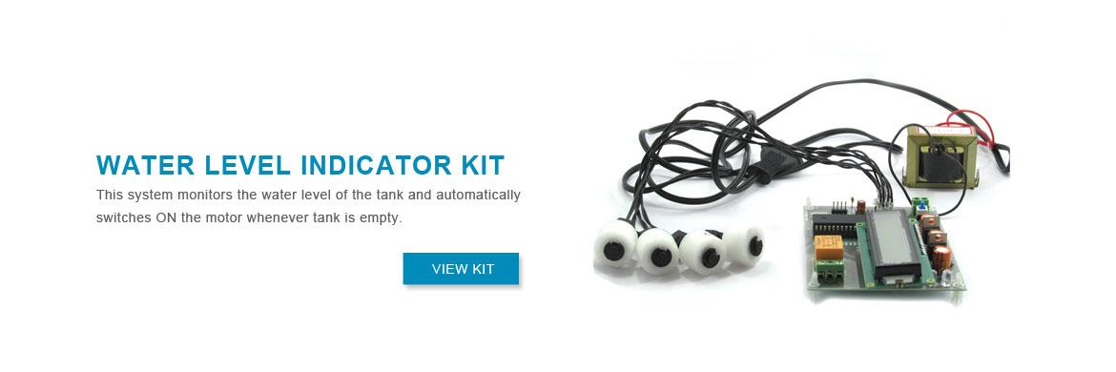

Slide 10
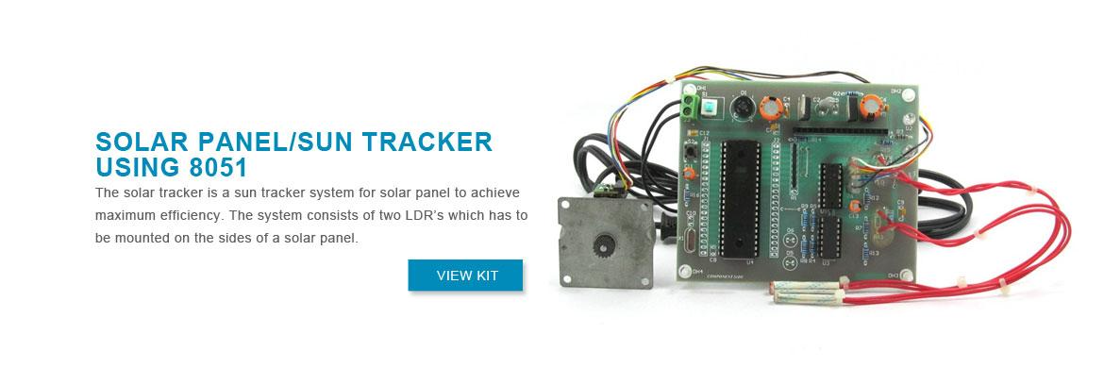

Slide 11
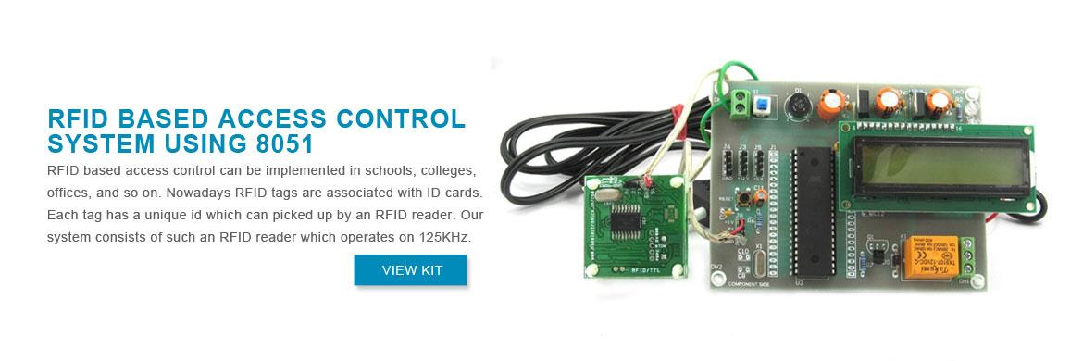

Slide 12
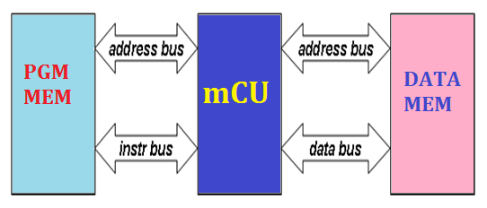
Harvard Architecture
In Harvard Architecture the data and instructions are stored in separate memory units each with their own bus.
Advantages:
Speeding up the data transfer rate,
Permits the designer to implement different bus widths and word sizes for program and data memory space.

Slide 13
8051 CPU Operation
Features
Pin Diagram
Block Diagram

Slide 14
8051 Microcontroller
Intel introduced 8051, referred as MCS- 51, in 1981.
The 8051 is an 8-bit processor
The CPU can work on only 8 bits of data at a time
The 8051 became widely popular after allowing other manufactures to make and market any flavor of the 8051.

Slide 15
Features of 8051
8 bit Processor
4KB Internal ROM
128 Bytes Internal RAM
Four 8 BIT I/O PORTS (32 I/O LINES)
Two 16 Bit Timers/Counters
On Chip Full Duplex UART for Serial Communication
5 Vector Interrupts ( 2 External, 3 Internal - Timer0,Timer1,Serial)
On Chip Clock Oscillator
16 bit Address bus
64k External Code Memory
64k External Data Memory
16-bit program counter to access external Code Memory and
16 bit Data Pointer to access external Data Memory
128 user defined flags
32 General Purpose Registers each of 8 bits

Slide 16
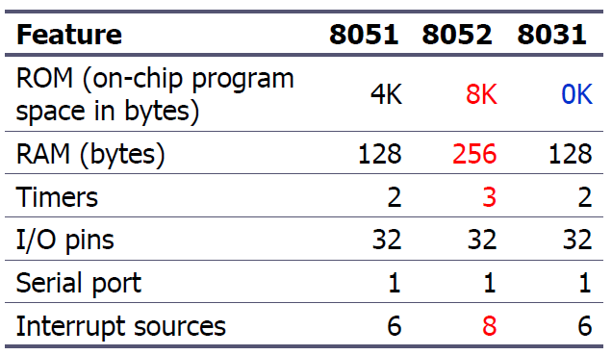
8051 Family
The 8051 is a subset of the 8052
The 8031 is a ROM-less 8051
Add external ROM to it
You lose two ports, and leave only 2 ports for I/O operations

Slide 17
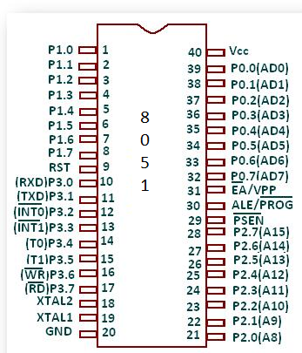
Pin Diagram

Slide 18
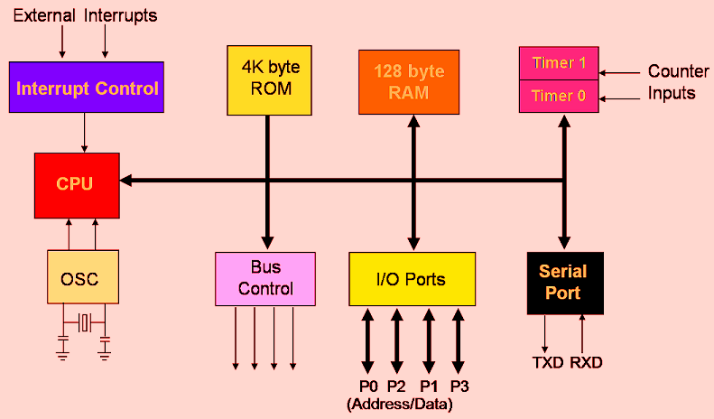
Block Diagram of 8051

Slide 19
Separate read instructions for external data and code memory.
Notes:
19

Slide 20
Pin Description of the 8051
8051 family members (e.g., 8751, 89C51, 89C52, DS89C4x0)
Have 40 pins dedicated for various functions such as I/O, RD, WR, address, data, and interrupts.
Come in different packages, such as
DIP(dual in-line package),
QFP(quad flat package), and
LLC(leadless chip carrier)
Some companies provide a 20-pin version of the 8051 with a reduced number of I/O ports for less demanding applications

Slide 21
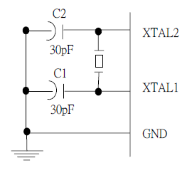
XTAL1 and XTAL2
The 8051 has an on-chip oscillator but requires an external crystal to run it
A quartz crystal oscillator is connected to inputs XTAL1 (pin19) and XTAL2 (pin18)
The quartz crystal oscillator also needs two capacitors of 30 pF value
The original 8051 operates at 12 MHZ

Slide 22
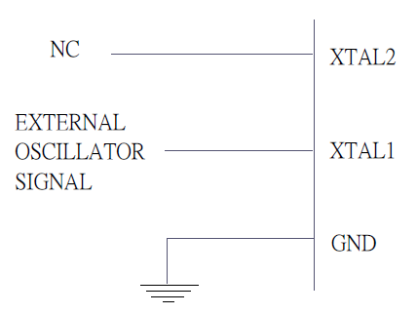
XTAL1 and XTAL2 …..
If you use a frequency source other than a crystal oscillator, such as a TTL oscillator:
It will be connected to XTAL1
XTAL2 is left unconnected

Slide 23
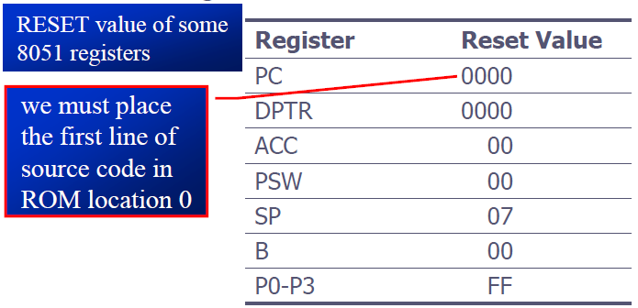
RST
RESET pin is an input and is active high (normally low)
Upon applying a high pulse to this pin, the microcontroller will reset and terminate all activities
This is often referred to as a power-on reset
Activating a power-on reset will cause all values in the registers to be lost

Slide 24
EA’
EA’, “external access’’, is an input pin and must be connected to Vcc or GND
The 8051 family members all come with on-chip ROM to store programs and also have an external code and data memory.
Normally EA pin is connected to Vcc (Internal Access)
EA pin must be connected to GND to indicate that the code or data is stored externally.

Slide 25
PSEN’ and ALE
PSEN, “program store enable’’, is an output pin
This pin is connected to the OE pin of the external memory.
For External Code Memory, PSEN’ = 0
For External Data Memory, PSEN’ = 1
ALE pin is used for demultiplexing the address and data.

Slide 26
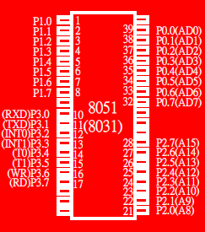
I/O Port Pins
The four 8-bit I/O ports P0, P1, P2 and P3 each uses 8 pins.
All the ports upon RESET are configured as output, ready to be used as input ports by the external device.

Slide 27
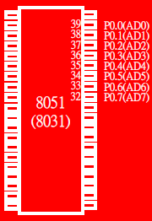
Port 0
Port 0 is also designated as AD0-AD7.
When connecting an 8051 to an external memory, port 0 provides both address and data.
The 8051 multiplexes address and data through port 0 to save pins.
ALE indicates if P0 has address or data.
When ALE=0, it provides data D0-D7
When ALE=1, it has address A0-A7

Slide 28
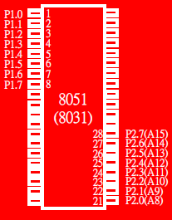
Port 1 and Port 2
In 8051-based systems with no external memory connection:
Both P1 and P2 are used as simple I/O.
In 8051-based systems with external memory connections:
Port 2 must be used along with P0 to provide the 16-bit address for the external memory.
P0 provides the lower 8 bits via A0 – A7.
P2 is used for the upper 8 bits of the 16-bit address, designated as A8 – A15, and it cannot be used for I/O.

Slide 29
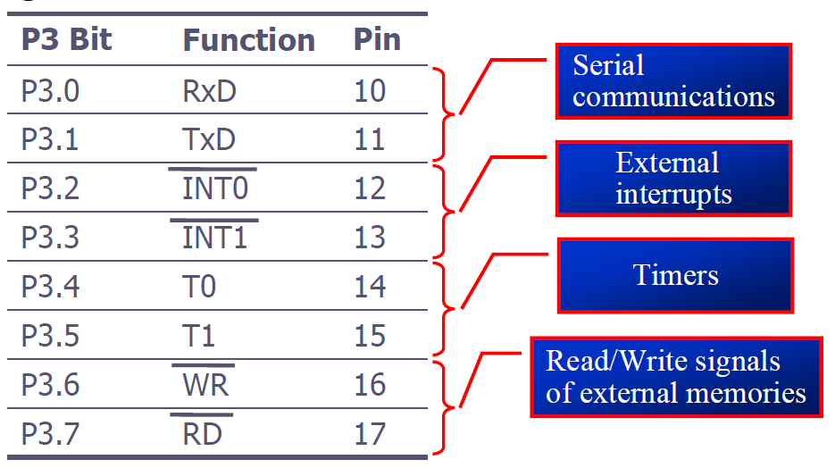
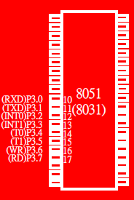
Port 3
Port 3 can be used as input or output.
Port 3 has the additional function of providing some extremely important signals

Slide 30
Pin Description Summary
PIN | TYPE | NAME AND FUNCTION
Vss | I | Ground: 0 V reference.
Vcc | I | Power Supply: This is the power supply voltage for normal, idle, and power-down operation.
P0.0 - P0.7 | I/O | Port 0: Port 0 is an open-drain, bi-directional I/O port. Port 0 is also the multiplexed low-order address and data bus during accesses to external program and data memory.
P1.0 - P1.7 | I/O | Port 1: Port I is an 8-bit bi-directional I/O port.
P2.0 - P2.7 | I/O | Port 2: Port 2 is an 8-bit bidirectional I/O. Port 2 emits the high order address byte during fetches from external program memory and during accesses to external data memory that use 16 bit addresses.
P3.0 - P3.7 | I/O | Port 3: Port 3 is an 8 bit bidirectional I/O port. Port 3 also serves special features as explained.

Slide 31
Pin Description Summary
PIN | TYPE | NAME AND FUNCTION
RST | I | Reset: A high on this pin for two machine cycles while the oscillator is running, resets the device.
ALE | O | Address Latch Enable: Output pulse for latching the low byte of the address during an access to external memory.
PSEN* | O | Program Store Enable: The read strobe to external program memory. When executing code from the external program memory, PSEN* is activated twice each machine cycle, except that two PSEN* activations are skipped during each access to external data memory.
EA*/VPP | I | External Access Enable/Programming Supply Voltage: EA* must be externally held low to enable the device to fetch code from external program memory locations. If EA* Is held high, the device executes from internal program memory. This pin also receives the programming supply voltage Vpp during Flash programming. (applies for 89c5x MCU's)

Slide 32
General Block Diagram of 8051
4K
ROM
Interrupt
Control
128 B
RAM
Timer 0
Timer 1
CPU
Bus
Control
4 I/O Ports
Serial
Port
OSC
TXD
RXD
P0
P1
P2
P3

Slide 33
8051 Memory Space

Slide 34

8051 Memory Structure
External
60K
External
64K
64K
SFR
EXT
INT
4K
128
EA = 0
EA = 1
Internal
Program Memory
Data Memory

Slide 35
Internal RAM Structure
Direct
Addressing
Only
SFR [ Special Function Registers]
Direct &
Indirect
Addressing
128 Byte Internal RAM

Slide 36
STORAGE REGISTERS OF 8051 Accumulator R registers(R0-R7) B register Data Pointer (DPTR) Program Counter (PC) Stack Pointer (SP)

Slide 37
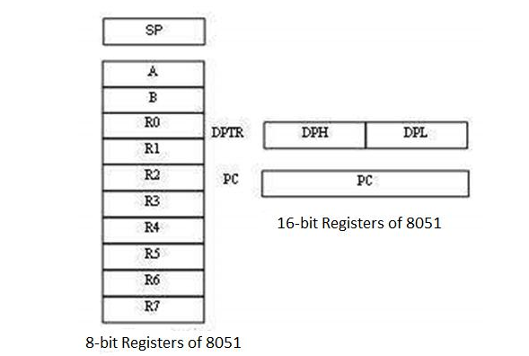
STORAGE REGISTERS OF 8051

Slide 38
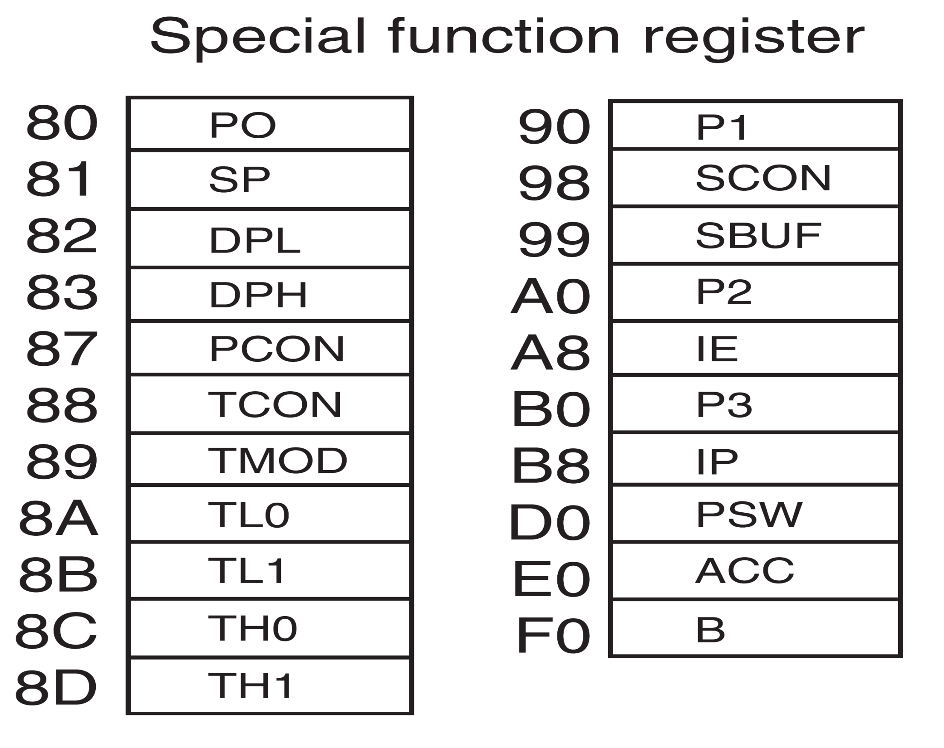
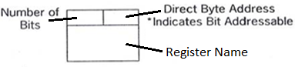
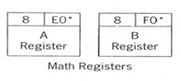
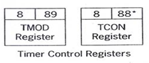
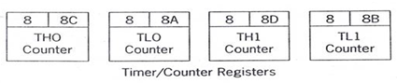
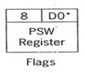
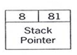
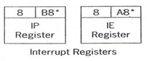
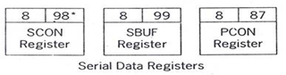
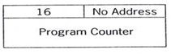
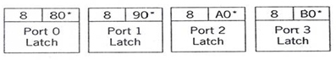
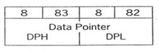
Special Function Registers [SFR]

Slide 39
Program Status Word [PSW]
C AC F0 RS1 RS0 OV F1 P
Carry
Parity
Auxiliary Carry
User Flag 1
User Flag 0
Register Bank Select
Overflow

Slide 40
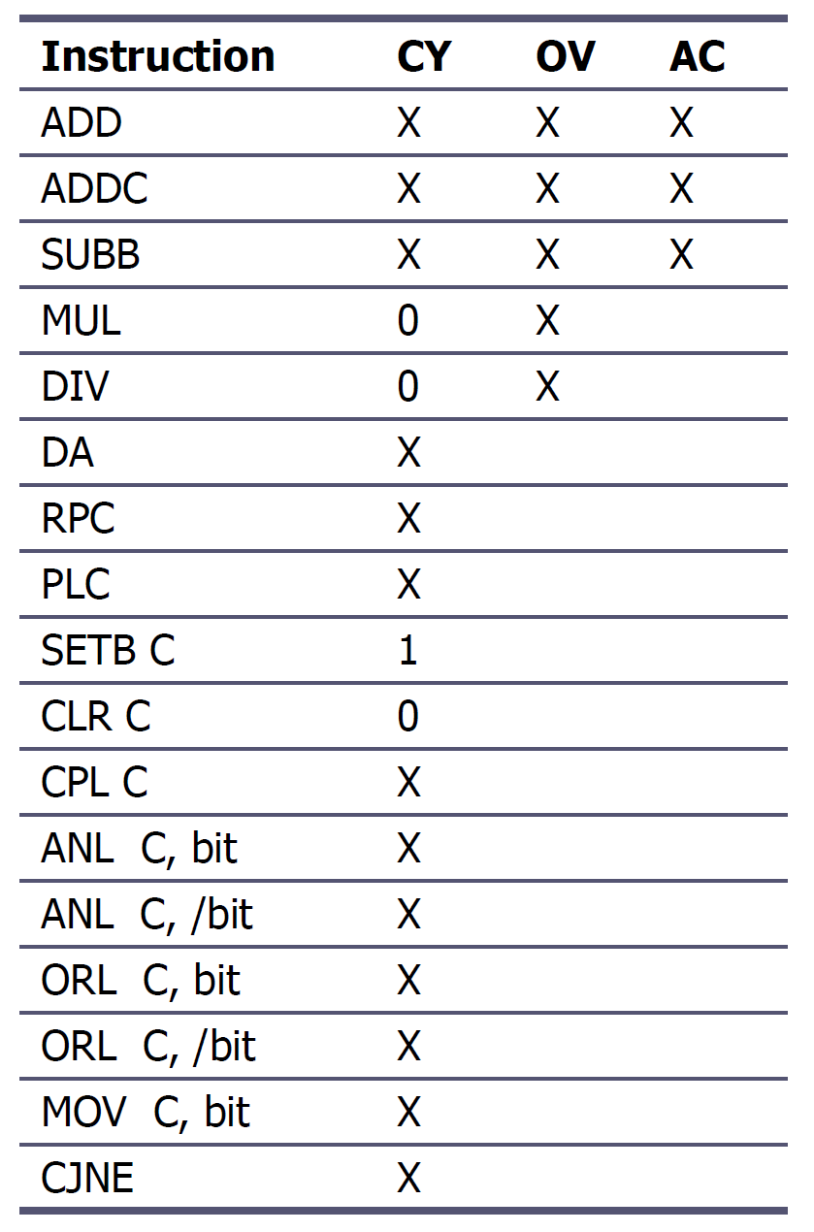
8051 instructions that affects flag

Slide 41
128 Byte RAM
There are 128 bytes of RAM in the 8051.
Assigned addresses 00 to 7FH
The 128 bytes are divided into 3 different groups as follows:
A total of 32 bytes from locations 00 to 1F hex are set aside for register banks and the stack.
A total of 16 bytes from locations 20H to 2FH are set aside for bit-addressable read/write memory.
A total of 80 bytes from locations 30H to 7FH are used for read and write storage, called scratch pad.
128 BYTE
INTERNAL RAM
General Purpose
Area
BIT Addressable
Area
Register Banks
Reg Bank 3
Reg Bank 2
Reg Bank 1
Reg Bank 0

Slide 42
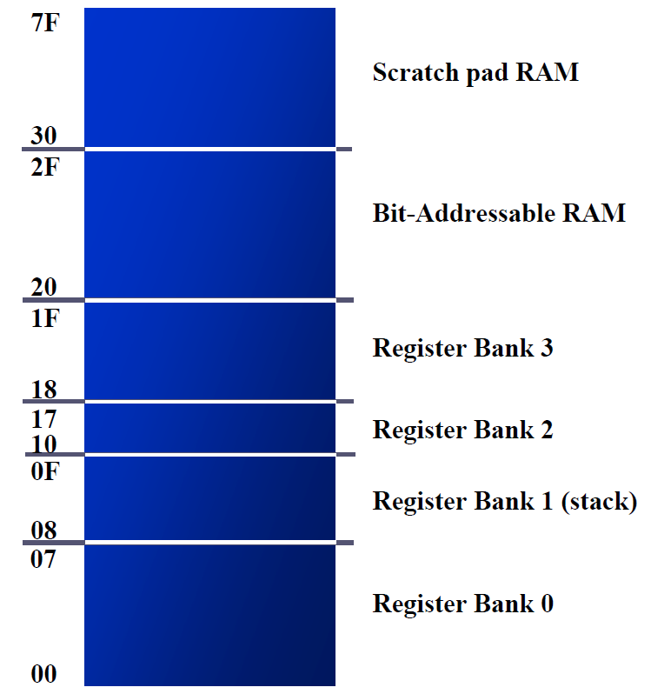
8051 RAM with addresses

Slide 43
8051 Register Bank Structure
Bank 3
R0 | R1 | R2 | R3 | R4 | R5 | R6 | R7
Bank 2
R0 | R1 | R2 | R3 | R4 | R5 | R6 | R7
Bank 1
R0 | R1 | R2 | R3 | R4 | R5 | R6 | R7
Bank 0
R0 | R1 | R2 | R3 | R4 | R5 | R6 | R7

Slide 44
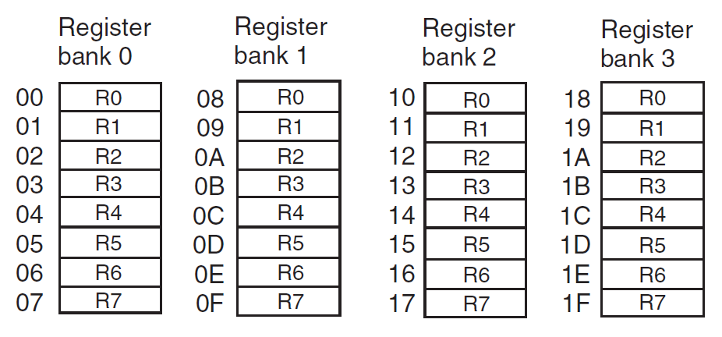
8051 Register Banks with address

Slide 45
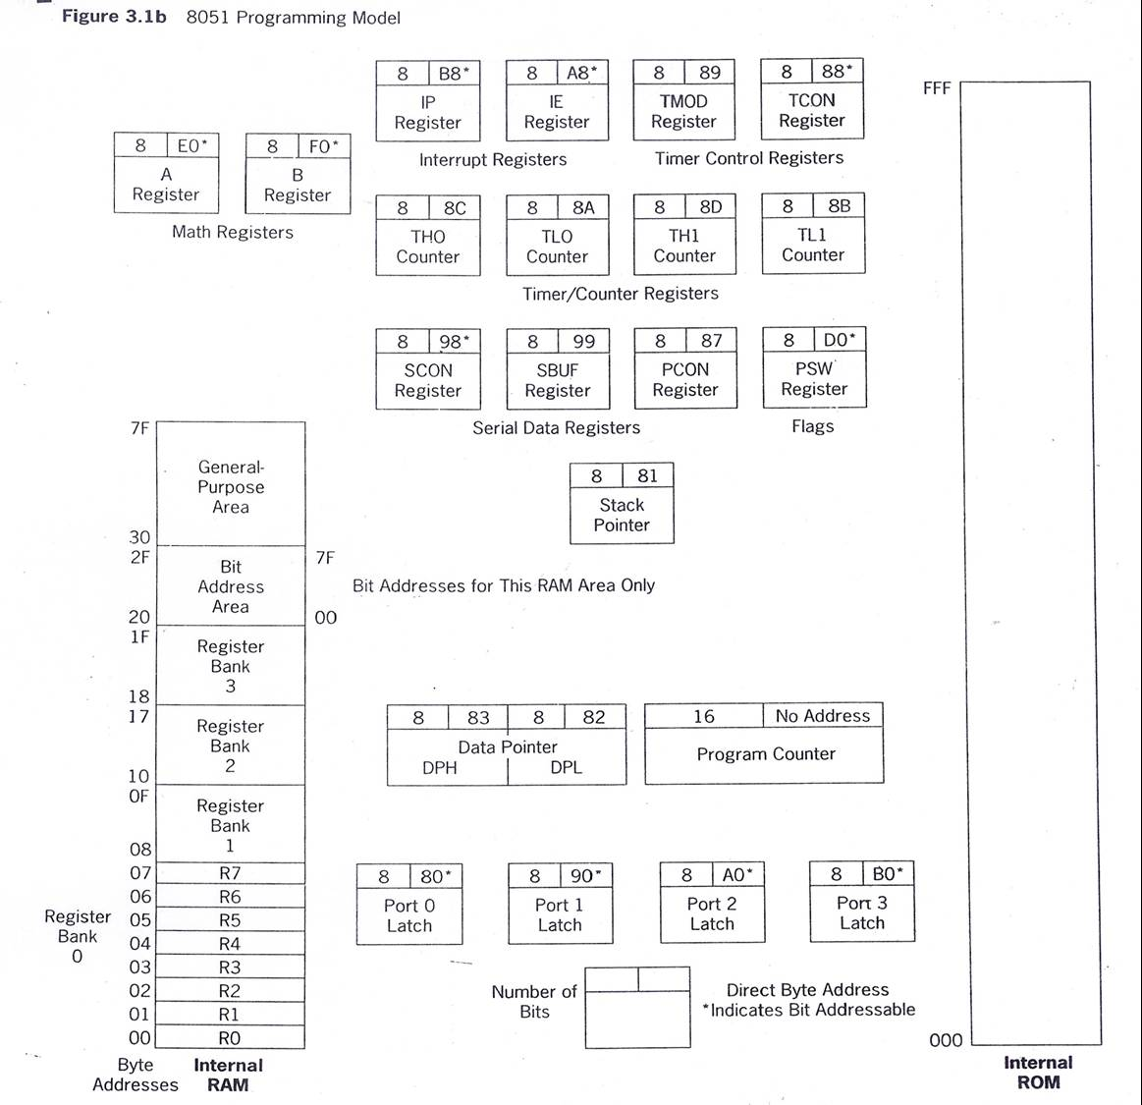
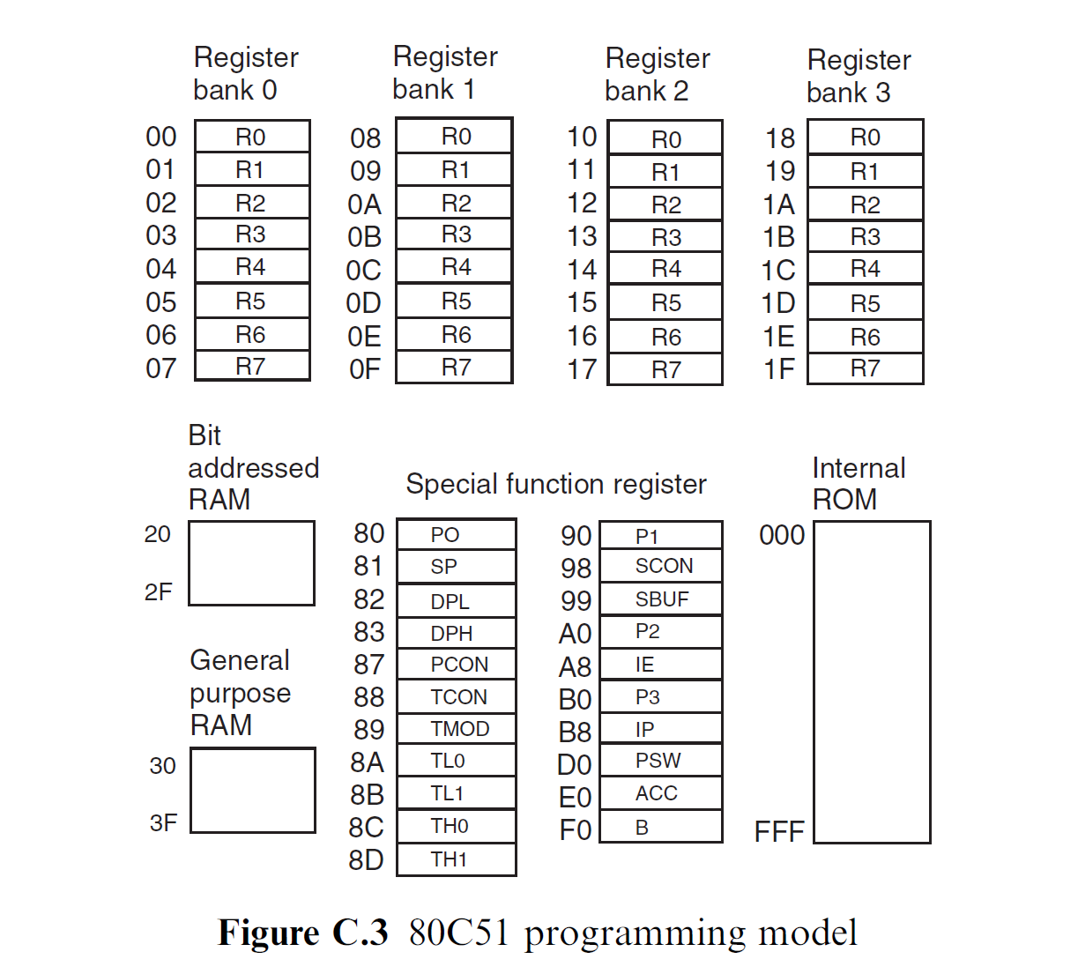
8051 Programming Model

Slide 46
8051 Stack
The stack is a section of RAM used by the CPU to store information temporarily.
This information could be data or an address
The register used to access the stack is called the SP (stack pointer) register
The stack pointer in the 8051 is only 8 bit wide, which means that it can take value of 00 to FFH
When the 8051 is powered up, the SP register contains value 07
RAM location 08 is the first location begin used for the stack by the 8051

Slide 47
8051 Stack
The storing of a CPU register in the stack is called a PUSH
SP is pointing to the last used location of the stack
As we push data onto the stack, the SP is incremented by one
This is different from many microprocessors
Loading the contents of the stack back into a CPU register is called a POP
With every pop, the top byte of the stack is copied to the register specified by the instruction and the stack pointer is decremented once

Slide 48
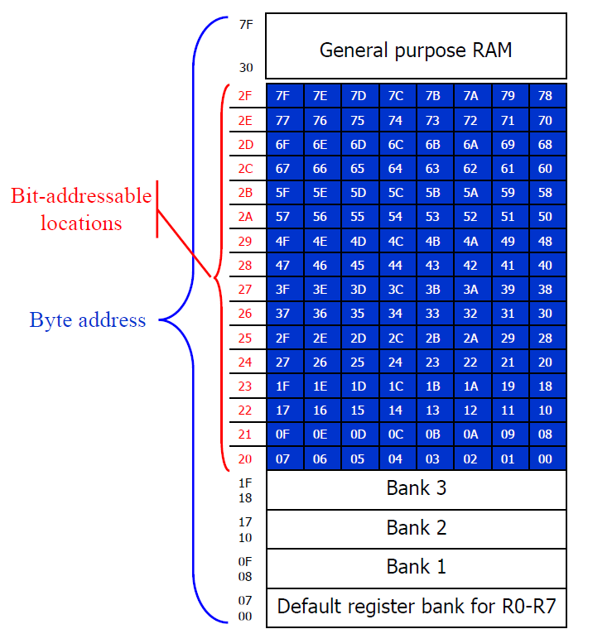
Bit Addressable & Byte Addressable

Slide 49
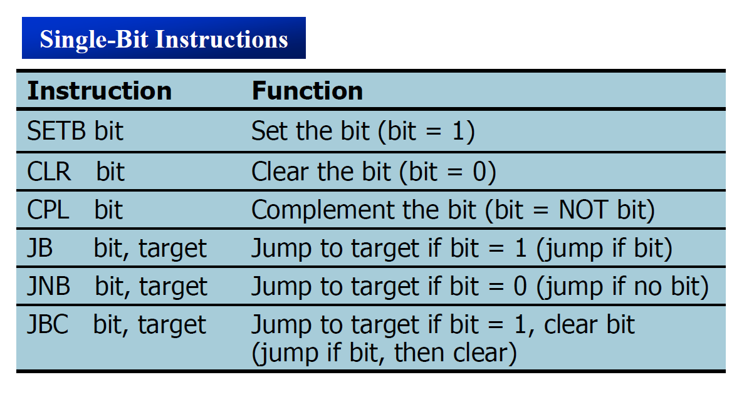
Single bit Instructions

Slide 50
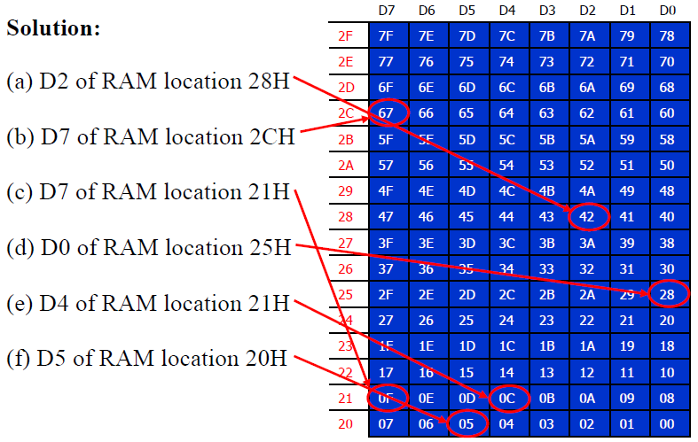
Bit Addressable Programming
Example: Find out to which by each of the following bits belongs. Give the address of the RAM byte in hex
(a) SETB 42H, (b) CLR 67H, (c) CLR 0FH (d) SETB 28H, (e) CLR 12, (f) SETB 05

Slide 51
8051 Software Overview
Addressing Modes
Instruction Set
Programming

Slide 52
8051 Addressing Modes
The CPU can access data in various ways, which are called addressing modes
Immediate
Register
Direct
Register indirect
External Direct

Slide 53
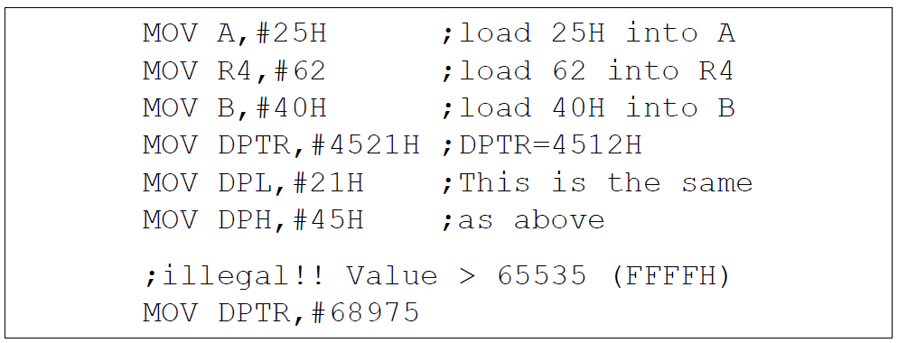
Immediate Addressing Mode
The source operand is a constant.
The immediate data must be preceded by the pound sign, “#”
Can load information into any registers, including 16-bit DPTR register
DPTR can also be accessed as two 8-bit registers, the high byte DPH and low byte DPL

Slide 54
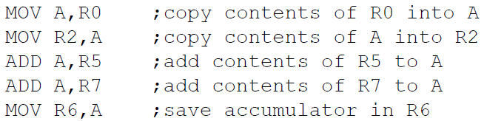
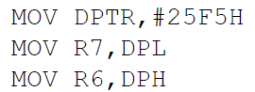
Register Addressing Mode
Use registers to hold the data to be manipulated.
The source and destination registers must match in size.
MOV DPTR,A will give an error
The movement of data between Rn registers is not allowed
MOV R4,R7 is invalid

Slide 55
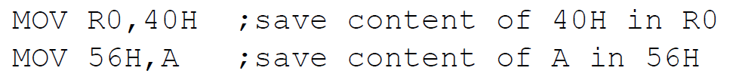
Direct Addressing Mode
It is most often used the direct addressing mode to access RAM locations 30 – 7FH.
The entire 128 bytes of RAM can be accessed.
Contrast this with immediate addressing mode, there is no “#” sign in the operand.

Slide 56
SFR Registers & their Addresses
MOV 0E0H,#55H ;is the same as
MOV A,#55H ;which means load 55H into A (A=55H)
MOV 0F0H,#25H ;is the same as
MOV B,#25H ;which means load 25H into B (B=25H)
MOV 0E0H,R2 ;is the same as
MOV A,R2 ;which means copy R2 into A
MOV 0F0H,R0 ;is the same as
MOV B,R0 ;which means copy R0 into B

Slide 57
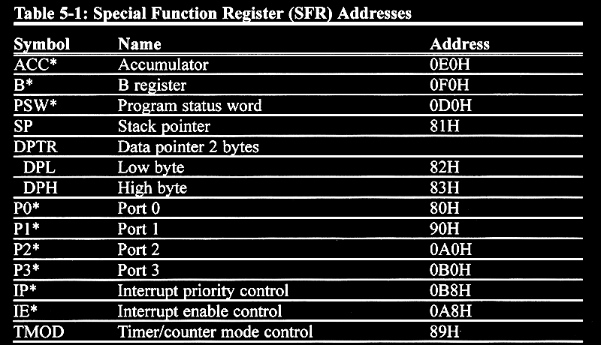
SFR Addresses ( 1 of 2 )

Slide 58
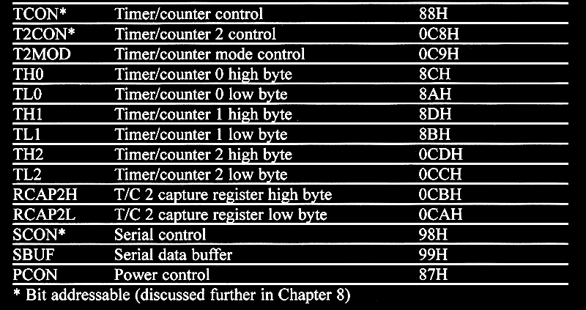
SFR Addresses ( 2 of 2 )

Slide 59
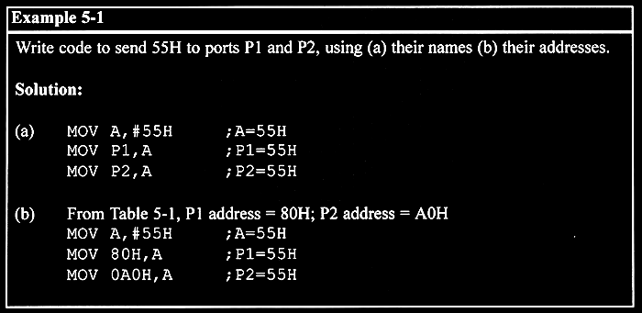
Example

Slide 60
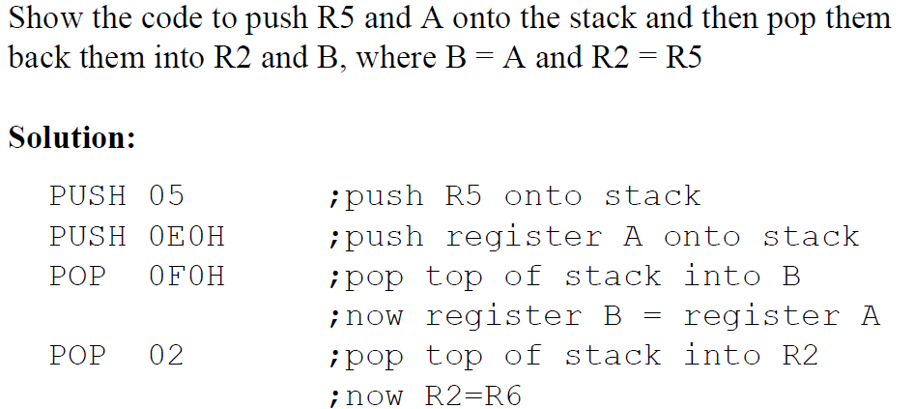
Stack and Direct Addressing Mode
Only direct addressing mode is allowed for pushing or popping the stack.
PUSH A is invalid.
Pushing the accumulator onto the stack must be coded as PUSH 0E0H.

Slide 61
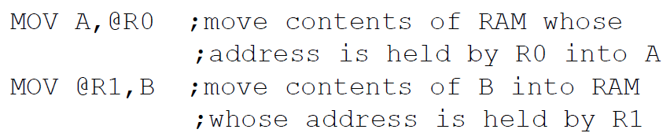
Register Indirect Addressing Mode
A register is used as a pointer to the data.
Only register R0 and R1 are used for this purpose.
R2 – R7 cannot be used to hold the address of an operand located in RAM.
When R0 and R1 hold the addresses of RAM locations, they must be preceded by the “@” sign.

Slide 62
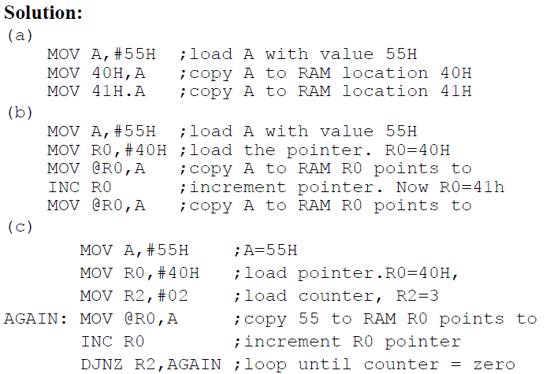
Register Indirect Addressing Mode
Write a program to copy the value 55H into RAM memory locations 40H to 41H using (a) direct addressing mode, (b) register indirect addressing mode without a loop, and (c) with a loop.

Slide 63

Register Indirect Addressing Mode
The advantage is that it makes accessing data dynamic rather than static as in direct addressing mode.
Looping is not possible in direct addressing mode.
Write a program to clear 16 RAM locations starting at RAM address 60H.

Slide 64
External Direct
External Memory is accessed.
There are only two commands that use External Direct addressing mode:
MOVX A, @DPTR MOVX @DPTR, A
DPTR must first be loaded with the address of external memory.

Slide 65
8051 Instruction Set
8051 instructions have 8-bit opcode
There are 256 possible instructions of which 255 are
implemented

Slide 66
MOV Instruction
MOV destination, source ; copy source to destination.
MOV A,#55H ;load value 55H into reg. A MOV R0,A ;copy contents of A into R0 ;(now A=R0=55H) MOV R1,A ;copy contents of A into R1 ;(now A=R0=R1=55H) MOV R2,A ;copy contents of A into R2 ;(now A=R0=R1=R2=55H) MOV R3,#95H ;load value 95H into R3 ;(now R3=95H) MOV A,R3 ;copy contents of R3 into A ;now A=R3=95H

Slide 67
ADD Instruction
ADD A, source ;ADD the source operand to the accumulator
MOV A, #25H ;load 25H into A MOV R2,#34H ;load 34H into R2 ADD A,R2 ;add R2 to accumulator ;(A = A + R2)

Slide 68
Structure of Assembly Language
ORG 0H ;start (origin) at location 0 MOV R5,#25H ;load 25H into R5 MOV R7,#34H ;load 34H into R7 MOV A,#0 ;load 0 into A ADD A,R5 ;add contents of R5 to A ;now A = A + R5 ADD A,R7 ;add contents of R7 to A ;now A = A + R7 ADD A,#12H ;add to A value 12H ;now A = A + 12H
HERE: SJMP HERE ;stay in this loop END ;end of asm source file

Slide 69
Data Types & Directives
ORG 500H
DATA1: DB 28 ;DECIMAL (1C in Hex)
DATA2: DB 00110101B ;BINARY (35 in Hex)
DATA3: DB 39H ;HEX
ORG 510H
DATA4: DB “2591” ; ASCII NUMBERS
ORG 518H
DATA6: DB “My name is Joe” ;ASCII CHARACTERS

Slide 70

ADD Instruction and PSW

Slide 71

ADD Instruction and PSW

Slide 72
Multiplication of Unsigned Numbers
MUL AB ; A × B, place 16-bit result in B and A
MOV A,#25H ;load 25H to reg. A
MOV B,#65H ;load 65H in reg. B
MUL AB ;25H * 65H = E99 where B = 0EH and A = 99H
Table 6-1:Unsigned Multiplication Summary (MUL AB)
Multiplication | Operand 1 | Operand 2 | Result
byte × byte | A | B | A=low byte, B=high byte

Slide 73
Division of Unsigned Numbers
DIV AB ; divide A by B
MOV A,#95H ;load 95 into A
MOV B,#10H ;load 10 into B
DIV AB ;now A = 09 (quotient) and B = 05 (remainder)
Table 6-2:Unsigned Division Summary (DIV AB)
Division | Numerator | Denominator | Quotient | Remainder
byte / byte | A | B | A | B

Slide 74

Checking an input bit
JNB (jump if no bit) ; JB (jump if bit = 1)

Slide 75

Switch Register Banks

Slide 76

Pushing onto Stack

Slide 77

Popping from Stack

Slide 78

Looping

Slide 79

Loop inside a Loop (Nested Loop)

Slide 80

8051 Conditional Jump Instructions

Slide 81


Slide 82

Conditional Jump Example

Slide 83

Conditional Jump Example

Slide 84
Unconditional Jump Instructions
All conditional jumps are short jumps
Target address within -128 to +127 of PC
LJMP (long jump): 3-byte instruction
2-byte target address: 0000 to FFFFH
Original 8051 has only 4KB on-chip ROM
SJMP (short jump): 2-byte instruction
1-byte relative address: -128 to +127

Slide 85
Call Instructions
LCALL (long call): 3-byte instruction
2-byte address
Target address within 64K-byte range
ACALL (absolute call): 2-byte instruction
11-bit address
Target address within 2K-byte range

Slide 86
Separate read instructions for external data and code memory.
Notes:
86

Slide 87

Return

Slide 88
8051 Peripheral Overview
Timers
Serial Port
Interrupts

Slide 89
8051 TIMERS

Slide 90


8051 Timer/Counter
OSC
÷12
TLx
(8 Bit)
THx
(8 Bit)
TFx
(1 Bit)
INTERRUPT

Slide 91

TMOD Register
GATE:
When set, timer/counter x is enabled, if INTx pin is high and TRx is set.
When cleared, timer/counter x is enabled, if TRx bit set.
C/T*:
When set, counter operation (input from Tx input pin).
When cleared, timer operation (input from internal clock).

Slide 92

TMOD Register
The TMOD byte is not bit addressable.

Slide 93


TCON Register

Slide 94
8051 Timer Modes
8051 TIMERS
Timer 0
Timer 1
Mode 0
Mode 0
Mode 1
Mode 1
Mode 2
Mode 2
Mode 3

Slide 95
TIMER 0
OSC
÷12
TL0
TH0
TF0
INTERRUPT

Slide 96
TIMER 0 – Mode 0
13 Bit Timer / Counter
OSC
÷12
TL0
(5 Bit)
TH0
(8 Bit)
TF0
INTERRUPT
Maximum Count = 1FFFh (0001111111111111)

Slide 97
TIMER 0 – Mode 1
16 Bit Timer / Counter
OSC
÷12
TL0
(8 Bit)
TH0
(8 Bit)
TF0
INTERRUPT
Maximum Count = FFFFh (1111111111111111)

Slide 98
TIMER 0 – Mode 2
8 Bit Timer / Counter with AUTORELOAD
OSC
÷12
TL0
(8 Bit)
TH0
(8 Bit)
TF0
INTERRUPT
Reload
TH0
(8 Bit)
Maximum Count = FFh (11111111)

Slide 99
TIMER 0 – Mode 3
Two - 8 Bit Timer / Counter
OSC
÷12
TL0
(8 Bit)
TF0
INTERRUPT
OSC
÷12
TH0
(8 Bit)
TF1
INTERRUPT

Slide 100
TIMER 1
OSC
÷12
TL1
TH1
TF1
INTERRUPT

Slide 101
TIMER 1 – Mode 0
13 Bit Timer / Counter
OSC
÷12
TL1
(5 Bit)
TH1
(8 Bit)
TF1
INTERRUPT
Maximum Count = 1FFFh (0001111111111111)

Slide 102
TIMER 1 – Mode 1
16 Bit Timer / Counter
OSC
÷12
TL1
(8 Bit)
TH1
(8 Bit)
TF1
INTERRUPT
Maximum Count = FFFFh (1111111111111111)

Slide 103
TIMER 1 – Mode 2
8 Bit Timer / Counter with AUTORELOAD
OSC
÷12
TL1
(8 Bit)
TH1
(8 Bit)
TF1
INTERRUPT
Reload
TH1
(8 Bit)
Maximum Count = FFh (11111111)

Slide 104
Programming Timers
Example: Indicate which mode and which timer are selected for each of the following.
(a) MOV TMOD, #01H (b) MOV TMOD, #20H (c) MOV TMOD, #12H
Solution: We convert the value from hex to binary.
(a) TMOD = 00000001, mode 1 of timer 0 is selected.
(b) TMOD = 00100000, mode 2 of timer 1 is selected.
(c) TMOD = 00010010, mode 2 of timer 0, and mode 1 of timer 1
are selected.

Slide 105

Programming Timers
Find the timer’s clock frequency and its period for various 8051-based system, with the crystal frequency 11.0592 MHz when C/T bit of TMOD is 0.
Solution:
1/12 × 11.0529 MHz = 921.6 MHz;
T = 1/921.6 kHz = 1.085 us

Slide 106
8051 Serial Port

Slide 107

Basics of Serial Communication
Computers transfer data in two ways:
Parallel: Often 8 or more lines (wire conductors) are used to transfer data to a device that is only a few feet away.
Serial: To transfer to a device located many meters away, the serial method is used. The data is sent one bit at a time.

Slide 108
Basics of Serial Communication
Serial data communication uses two methods
Synchronous method transfers a block of data at a time
Asynchronous method transfers a single byte at a time
There are special IC’s made by many manufacturers for serial communications.
UART (universal asynchronous Receiver transmitter)
USART (universal synchronous-asynchronous Receiver-transmitter)

Slide 109
Asynchronous – Start & Stop Bit
Asynchronous serial data communication is widely used for character-oriented transmissions
Each character is placed in between start and stop bits, this is called framing.
Block-oriented data transfers use the synchronous method.
The start bit is always one bit, but the stop bit can be one or two bits
The start bit is always a 0 (low) and the stop bit(s) is 1 (high)

Slide 110

Asynchronous – Start & Stop Bit

Slide 111
Data Transfer Rate
The rate of data transfer in serial data communication is stated in bps (bits per second).
Another widely used terminology for bps is baud rate.
It is modem terminology and is defined as the number of signal changes per second
In modems, there are occasions when a single change of signal transfers several bits of data
As far as the conductor wire is concerned, the baud rate and bps are the same.

Slide 112
8051 Serial Port
Synchronous and Asynchronous
SCON Register is used to Control
Data Transfer through TXd & RXd pins
Some time - Clock through TXd Pin
Four Modes of Operation:
Mode 0 :Synchronous Serial Communication
Mode 1 :8-Bit UART with Timer Data Rate
Mode 2 :9-Bit UART with Set Data Rate
Mode 3 :9-Bit UART with Timer Data Rate

Slide 113
Registers related to Serial Communication
SBUF Register
SCON Register
PCON Register

Slide 114
SBUF Register
SBUF is an 8-bit register used solely for serial communication.
For a byte data to be transferred via the TxD line, it must be placed in the SBUF register.
The moment a byte is written into SBUF, it is framed with the start and stop bits and transferred serially via the TxD line.
SBUF holds the byte of data when it is received by 8051 RxD line.
When the bits are received serially via RxD, the 8051 deframes it by eliminating the stop and start bits, making a byte out of the data received, and then placing it in SBUF.

Slide 115

SBUF Register
Sample Program:

Slide 116

SCON Register
SM0 SM1 SM2 REN TB8 RB8 TI RI
Set when a Cha-
ractor received
Set to Enable
Serial Data
reception
Set when Stop bit Txed
Enable Multiprocessor
Communication Mode
9th Data Bit
Sent in Mode 2,3
9th Data Bit
Received in Mode 2,3

Slide 117
8051 Serial Port – Mode 0
The Serial Port in Mode-0 has the following features:
Serial data enters and exits through RXD
TXD outputs the clock
8 bits are transmitted / received
The baud rate is fixed at (1/12) of the oscillator frequency

Slide 118
8051 Serial Port – Mode 1
The Serial Port in Mode-1 has the following features:
Serial data enters through RXD
Serial data exits through TXD
On receive, the stop bit goes into RB8 in SCON
10 bits are transmitted / received
Start bit (0)
Data bits (8)
Stop Bit (1)
Baud rate is determined by the Timer 1 over flow rate.

Slide 119
8051 Serial Port – Mode 2
The Serial Port in Mode-2 has the following features:
Serial data enters through RXD
Serial data exits through TXD
9th data bit (TB8) can be assign value 0 or 1
On receive, the 9th data bit goes into RB8 in SCON
11 bits are transmitted / received
Start bit (0)
Data bits (9)
Stop Bit (1)
Baud rate is programmable

Slide 120
8051 Serial Port – Mode 3
The Serial Port in Mode-3 has the following features:
Serial data enters through RXD
Serial data exits through TXD
9th data bit (TB8) can be assign value 0 or 1
On receive, the 9th data bit goes into RB8 in SCON
11 bits are transmitted / received
Start bit (0)
Data bits (9)
Stop Bit (1)
Baud rate is determined by Timer 1 overflow rate.

Slide 121
Programming Serial Data Transmission
1. TMOD register is loaded with the value 20H, indicating the use of timer 1 in mode 2 (8-bit auto-reload) to set baud rate.
2. The TH1 is loaded with one of the values to set baud rate for serial data transfer.
3. The SCON register is loaded with the value 50H, indicating serial mode 1, where an 8- bit data is framed with start and stop bits.
4. TR1 is set to 1 to start timer 1
5. TI is cleared by CLR TI instruction
6. The character byte to be transferred serially is written into SBUF register.
7. The TI flag bit is monitored with the use of instruction JNB TI, xx to see if the character has been transferred completely.
8. To transfer the next byte, go to step 5

Slide 122
Programming Serial Data Reception
1. TMOD register is loaded with the value 20H, indicating the use of timer 1 in mode 2 (8-bit auto-reload) to set baud rate.
2. TH1 is loaded to set baud rate
3. The SCON register is loaded with the value 50H, indicating serial mode 1, where an 8- bit data is framed with start and stop bits.
4. TR1 is set to 1 to start timer 1
5. RI is cleared by CLR RI instruction
6. The RI flag bit is monitored with the use of instruction JNB RI, xx to see if an entire character has been received yet
7. When RI is raised, SBUF has the byte, its contents are moved into a safe place.
8. To receive the next character, go to step 5.

Slide 123
Doubling Baud Rate
There are two ways to increase the baud rate of data transfer
By using a higher frequency crystal
By changing a bit in the PCON register
PCON register is an 8-bit register.
When 8051 is powered up, SMOD is zero
We can set it to high by software and thereby double the baud rate.

Slide 124



Doubling Baud Rate (cont…)

Slide 125
8051 Interrupts

Slide 126
INTERRUPTS
An interrupt is an external or internal event that interrupts the microcontroller to inform it that a device needs its service
A single microcontroller can serve several devices by two ways:
Interrupt
Polling

Slide 127
Interrupt Vs Polling
Interrupts
Whenever any device needs its service, the device notifies the microcontroller by sending it an interrupt signal.
Upon receiving an interrupt signal, the microcontroller interrupts whatever it is doing and serves the device.
The program which is associated with the interrupt is called the interrupt service routine (ISR) or interrupt handler.
Polling
The microcontroller continuously monitors the status of a given device.
When the conditions met, it performs the service.
After that, it moves on to monitor the next device until every one is serviced.

Slide 128
Interrupt Vs Polling
The polling method is not efficient, since it wastes much of the microcontroller’s time by polling devices that do not need service.
The advantage of interrupts is that the microcontroller can serve many devices (not all at the same time).
Each devices can get the attention of the microcontroller based on the assigned priority.
For the polling method, it is not possible to assign priority since it checks all devices in a round-robin fashion.
The microcontroller can also ignore (mask) a device request for service in Interrupt.

Slide 129

Steps in Executing an Interrupt
It finishes the instruction it is executing and saves the address of the next instruction (PC) on the stack.
It also saves the current status of all the interrupts internally (i.e: not on the stack).
It jumps to a fixed location in memory, called the interrupt vector table, that holds the address of the ISR.
The microcontroller gets the address of the ISR from the interrupt vector table and jumps to it.
It starts to execute the interrupt service subroutine until it reaches the last instruction of the subroutine which is RETI (return from interrupt).
Upon executing the RETI instruction, the microcontroller returns to the place where it was interrupted.

Slide 130
Six Interrupts in 8051
Six interrupts are allocated as follows:
Reset – power-up reset.
Two interrupts are set aside for the timers.
one for timer 0 and one for timer 1
Two interrupts are set aside for hardware external interrupts.
P3.2 and P3.3 are for the external hardware interrupts INT0 (or EX1), and INT1 (or EX2)
Serial communication has a single interrupt that belongs to both receive and transfer.

Slide 131
What events can trigger Interrupts?
We can configure the 8051 so that any of the following events will cause an interrupt:
Timer 0 Overflow.
Timer 1 Overflow.
Reception/Transmission of Serial Character.
External Event 0.
External Event 1.
We can configure the 8051 so that when Timer 0 Overflows or when a character is sent/received, the appropriate interrupt handler routines are called.

Slide 132

8051 Interrupt Vectors

Slide 133
8051 Interrupt related Registers
The various registers associated with the use of interrupts are:
TCON - Edge and Type bits for External Interrupts 0/1
SCON - RI and TI interrupt flags for RS232
IE - Enable interrupt sources
IP - Specify priority of interrupts

Slide 134
Enabling and Disabling an Interrupt
Upon reset, all interrupts are disabled (masked), meaning that none will be responded to by the microcontroller if they are activated.
The interrupts must be enabled by software in order for the microcontroller to respond to them.
There is a register called IE (interrupt enable) that is responsible for enabling (unmasking) and disabling (masking) the interrupts.

Slide 135

Interrupt Enable (IE) Register
--
EA : Global enable/disable.
--- : Reserved for additional interrupt hardware.
ES : Enable Serial port interrupt.
ET1 : Enable Timer 1 control bit.
EX1 : Enable External 1 interrupt.
ET0 : Enable Timer 0 control bit.
EX0 : Enable External 0 interrupt.
MOV IE,#08h or
SETB ET1

Slide 136
Enabling and Disabling an Interrupt
Example: Show the instructions to (a) enable the serial interrupt, timer 0 interrupt, and external hardware interrupt 1 and (b) disable (mask) the timer 0 interrupt, then (c) show how to disable all the interrupts with a single instruction.
Solution:
(a) MOV IE,#10010110B ;enable serial, timer 0, EX1
Another way to perform the same manipulation is:
SETB IE.7 ;EA=1, global enable
SETB IE.4 ;enable serial interrupt
SETB IE.1 ;enable Timer 0 interrupt
SETB IE.2 ;enable EX1
(b) CLR IE.1 ;mask (disable) timer 0 interrupt only
(c) CLR IE.7 ;disable all interrupts

Slide 137

Interrupt Priority
When the 8051 is powered up, the priorities are assigned according to the following.
In reality, the priority scheme is nothing but an internal polling sequence in which the 8051 polls the interrupts in the sequence listed and responds accordingly.

Slide 138
Interrupt Priority
We can alter the sequence of interrupt priority by assigning a higher priority to any one of the interrupts by programming a register called IP (interrupt priority).
To give a higher priority to any of the interrupts, we make the corresponding bit in the IP register high.

Slide 139
Interrupt Priority (IP) Register
PS PT1 PX1 PT0 PX0
Reserved
Serial Port
INT 0 Pin
Timer 1 Pin
INT 1 Pin
Timer 0 Pin
Priority bit=1 assigns high priority
Priority bit=0 assigns low priority

